Slide 1

Types of Fruits

Slide 2
Types of Fruits

Slide 3
Indehiscent Fruits
Dry fruits which do not split along definite lines to release seeds at maturity.

Slide 4
Examples:
Achene
Samara
Caryopsis
Nut

Slide 5
Achene
Seed coat not fused with ovary wall.

Slide 6

Achene: Sunflower Seed

Slide 7
Samara
Ovary wall forms a winglike structure.
Dry; frequently used for seed dispersal by wind.

Slide 8

Samara: maple

Slide 9
Caryopsis (grain)
Seed coat fused with ovary wall.

Slide 10
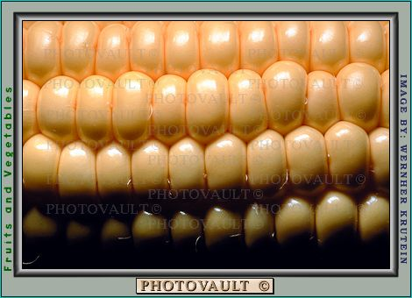
Caryopsis(grain): corn

Slide 11
Nut
Ovary wall is tough and woody.

Slide 12

Nut: acorn

Slide 13
Dehiscent fruits
Fruits which open at maturity to shed their seeds.

Slide 14
Examples:
Follicle
Legume
Capsule

Slide 15
Follicle
Fruit splits open along ONE seam.

Slide 16

Follicle: milkweed

Slide 17
Legume
Fruit splits open along TWO seams.

Slide 18

Legume: bean

Slide 19
Capsule
Fruit opens by various means, usually along more than two seams.

Slide 20
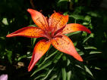
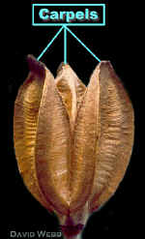
Capsule: lily

Slide 21
Fleshy Fruits
Fruit is generally moist and often edible.

Slide 22
Examples:
Drupe
Berry
False Berry
Hesperidium
Pome

Slide 23
Drupe
Fruit is fleshy all the way out to the covering.
Woody interior covering. The seed is covered by a very hard cover. Sometimes these are called stone fruits.

Slide 24

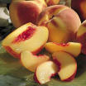
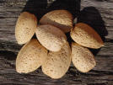
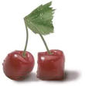
Drupe: plum, peach, almond, cherry

Slide 25
Berry
Fruit is fleshy all the way out to the covering, which is usually thin.
Interior seeds are NOT covered by a hard coat.

Slide 26
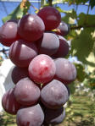

Berry: grape, tomato

Slide 27
False Berry
Looks like a berry, but often has a harder outer coat. Seeds are clustered in the middle rather than throughout the fruit.

Slide 28

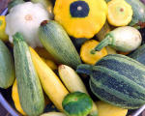
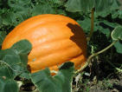
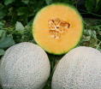
False Berry: cucumber, squash, pumpkin, cantaloupe

Slide 29
Hesperidium (not on your key)
Outer soft rind which is white on the inside.
Citrus Fruits belong here.

Slide 30
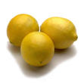

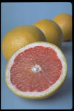
Hesperidium: orange, lemon, grapefruit

Slide 31
Pome
Fruit is fleshy out to the covering.
A few seeds are inside a core which is not eaten because it has a leathery interior coating.

Slide 32

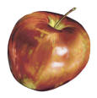
Pome: pear, apple

Slide 33

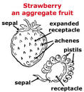
Aggregate Fruits
Fruit composed of mature ovaries from separate pistils of one flower
Example: raspberry, strawberry

Slide 34

Multiple Fruits
Fruit composed of mature ovaries from several flowers.
Example: pineapple

